Slide 1
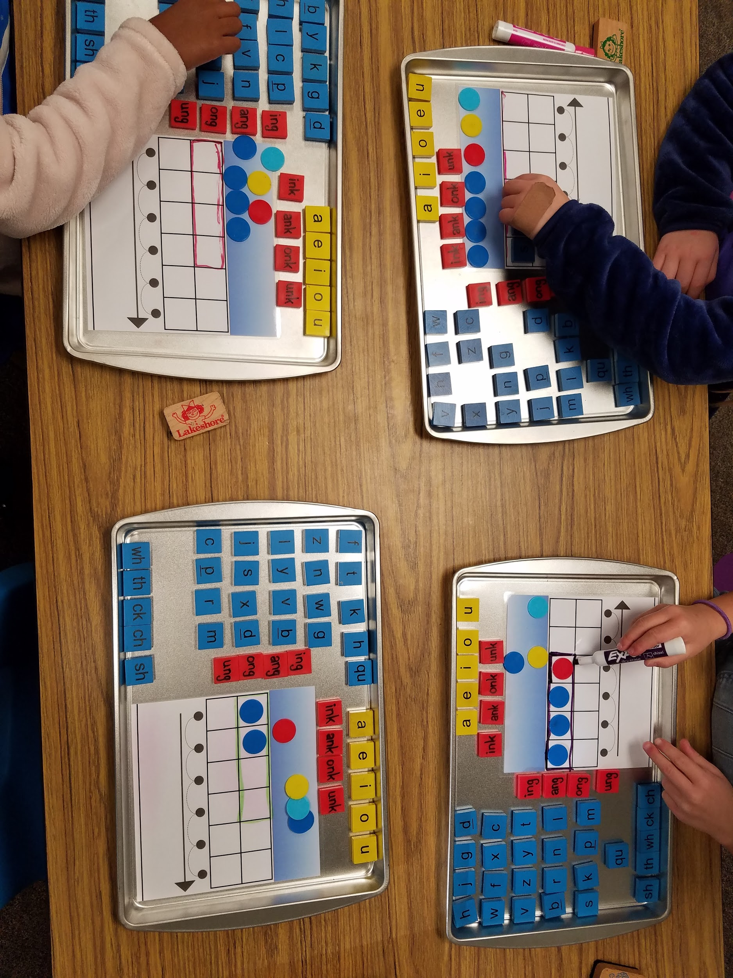
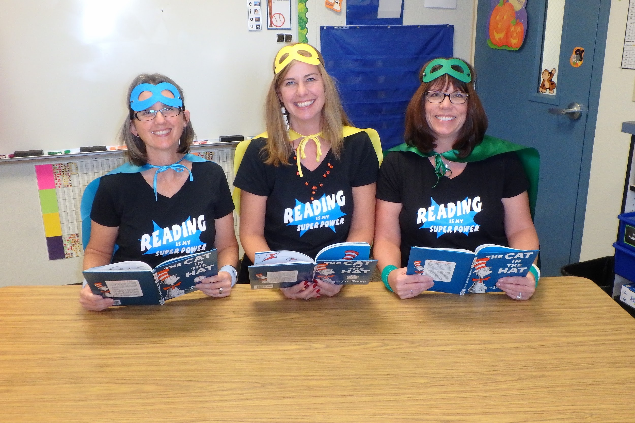
DYSLEXIA
San Ramon Valley Unified School District
October Resolution
Using Letter/Sound Trays
Teaching Reading is a SuperPower!

Slide 2
What is Dyslexia?
Research/Facts
Common Beliefs
Dyslexia is an auditory issue
It is genetic
It varies in intensity
It can impact speaking fluency (processing, storing, accessing)
Can have emotional consequences
Reversals of b/d p/q
Text moves on the page
Reading backwards
Eye or vision issues
Boys more than girls
Need to try harder
Dyslexia is a specific learning disability that is neurobiological in origin. It is characterized by difficulties with accurate and or fluent word recognition and poor spelling and decoding abilities.

Slide 3
The Ladder of Reading
5%
Learning to read seems effortless
Are advantaged by a structured literacy approach
35%
Learning to read is relatively easy with broad instruction
40 to 50%
Learning to read proficiently requires explicit, systematic instruction.
A structured literacy approach is essential.
10 to 15 %
Dyslexia
Learning to read requires explicit/systematic instruction.
www.nancyyoung.ca

Slide 4
THE MANY STRANDS THAT ARE WOVEN INTO SKILLED READING

Slide 5
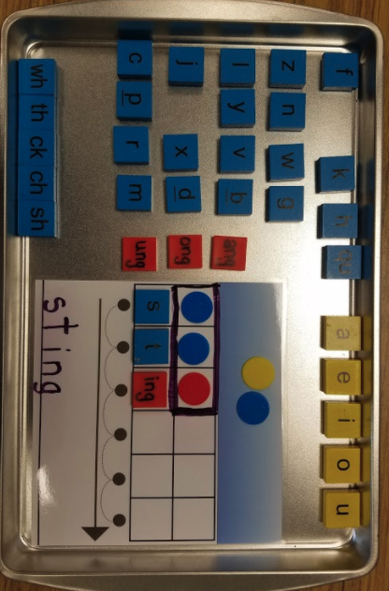
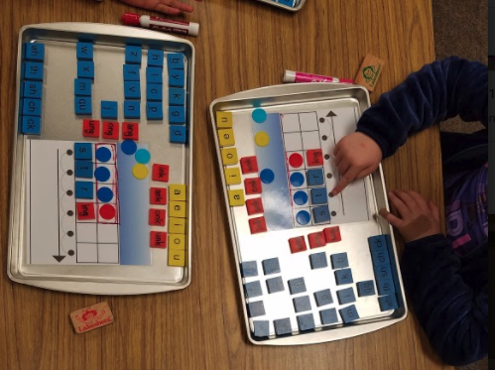
Reading and the Brain
The brain on the left is a child who is engaging in pre-reading activities. Looking at letters or performing a foundational task. The left hemisphere of this child’s brain is processing the information.
The brain on the right represents the brain of a child with Dyslexia. This child is performing the same foundational tasks but the brain is trying to process the information in the right hemisphere.
GREAT NEWS!
THE BRAIN CAN BE REWIRED THROUGH SYSTEMATIC AND EXPLICIT INSTRUCTION!

Slide 6
A Success Story
As told by a 2nd grade teacher:
Student S came to me at the beginning of 2nd grade last year as a level C reader. She has an IEP for Dyslexia. I began implementing phonemic awareness activities starting with beginning sounds. We moved into ending sounds and worked up to deletion and substitution. I had student S practice her skills by reading decodable texts. By the end of the year she moved up an entire level in reading. She was not at grade level but she was READING! It was crazy to watch how her brain rewired as she was engaged in daily, explicit instruction!

Slide 7
Structured Literacy Instruction
The Key to Developing Readers K-12
Phonology
Sound/Symbol Association
Syllable Instruction
Morphology
Syntax
Semantics
Systematic and Cumulative Instruction
Explicit Instruction
Diagnostic Teaching

Slide 8
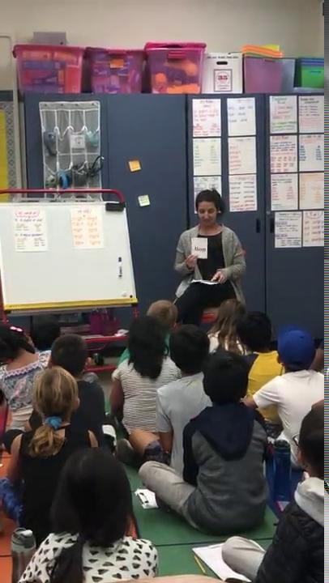
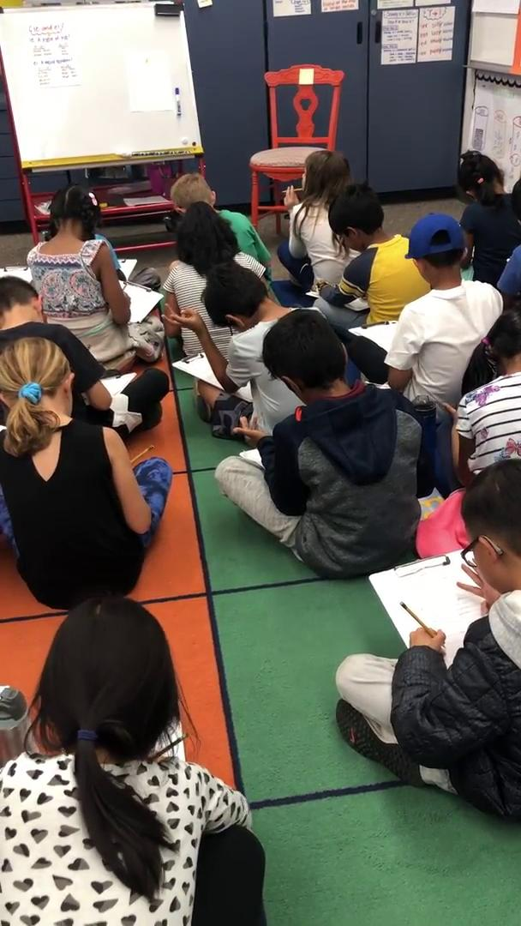
Structured Literacy In Action

Slide 9
Next Steps?
New Teacher Structured Literacy Training
District Literacy Study Team
Education!
Teaching the Why!
The Science of Reading P.L.
Ongoing Structured Literacy
Training
CORE Training and Professional Learning

Slide 10
